Slide 1
Chapter 12

Slide 2
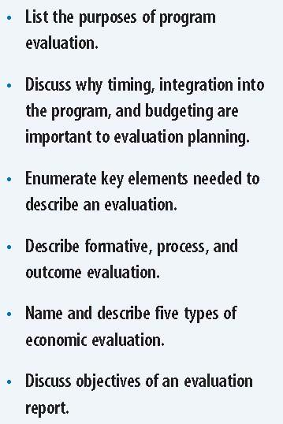
Learning Objectives

Slide 3
Overview of Program Evaluation
Evaluation differs from research
Primary purpose is to provide information to decision makers
Helps them make judgments about the effectiveness of a program and to improve it

Slide 4
Reasons to Evaluate Programs

Slide 5
Considerations in Program Evaluation
Evaluation planning
Should never be an after thought, but should begin before program is ever implemented
Evaluation should be integrated into the operation of the program
Budgeting for the evaluation should be part of program planning stage
Stakeholders
Must identify and engage stakeholders at beginning
All persons who have interest in the program

Slide 6
Program Evaluation Logic Model
Inputs
Activities
Outputs
Outcomes
Impact

Slide 7
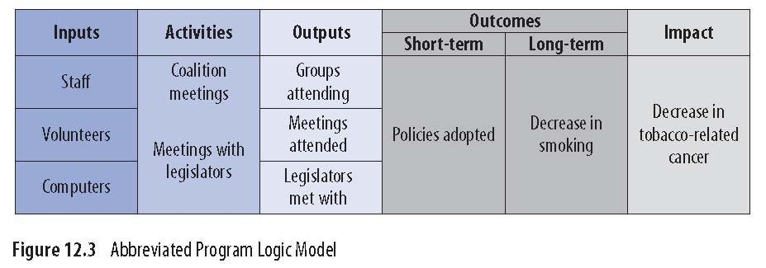
Abbreviated Program Logic Model

Slide 8
Types of Evaluation
Formative
Is the program feasible?
Process
How is the program being delivered?
Outcome
What are the short term effects of the program?
Economic
Are the effects worth the cost?

Slide 9
Formative Evaluation
Aims to improve the project’s design and performance
Should be conducted when program materials, messages, and procedures are being developed, before the program begins

Slide 10
Process Evaluation
Assesses program context, reach of the program, dose delivered and received, fidelity to the original program plan, implementation, and recruitment

Slide 11
Outcome Evaluation
Provides evidence of the degree to which a program is meeting its short-term or intermediate goals
Almost always uses experimental or quasi-experimental study
Did the program increase participants’ awareness of the hazards of radon gas, or changing their knowledge, attitudes, and beliefs about radon gas?

Slide 12
Economic Evaluation
Answers questions about the program’s affordability, efficiency, and standards the program must achieve to be considered cost-saving or cost-effective
Answers five cost-related evaluation questions:
(1) affordability
(2) costs of unmet needs
(3) performance standard setting
(4) comparing programs in one disease area to each other
(5) comparing programs in one area to health-related services in other disease areas

Slide 13
Affordability
Determines the price of delivering a program, and can provide detailed information about the exact types (and quantities) of resources consumed by the program

Slide 14
Cost of Unmet Needs Analysis
Answers the question, “How much would it cost to run a program that really addresses the unmet prevention service delivery needs of a population?”
Per-client costs of programs are multiplied by the number of people needing the programs
Yields the cost of unmet needs for a particular population

Slide 15
Threshold Analysis (Performance Standard Setting)
Answers the question, “How much disease would this program have to prevent in order to be cost-saving?”
Take the cost of a particular program and then divide it by the present value of the lifetime medical care cost of treating one case of the disease which the program is designed to prevent
Result tells us how many cases of disease would have to be permanently prevented by the program for it to be considered cost-saving

Slide 16
Cost-Effectiveness Analysis
Provides the cost-per-case of disease prevented by a given program in a given population
Must have all the associated costs
Can help decide which programs to fund (i.e., the one with the lowest cost per disease averted) given limited resources

Slide 17
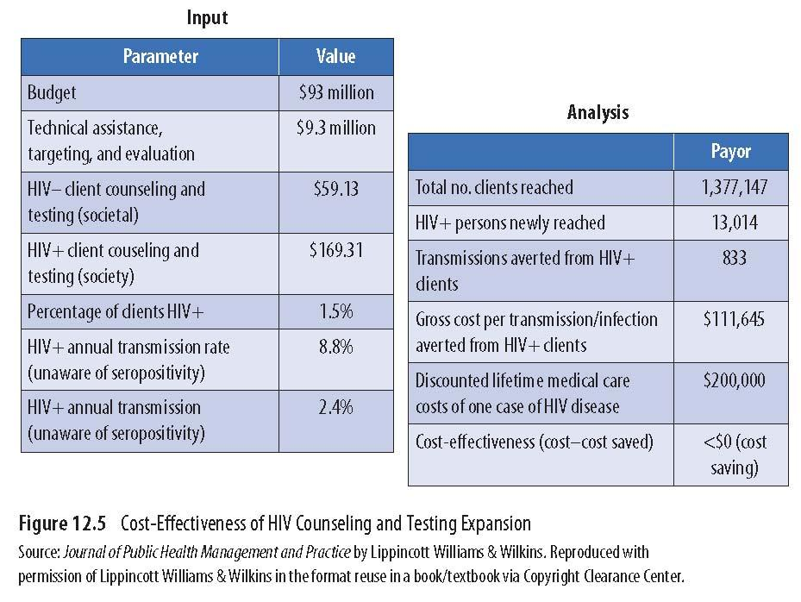
Cost-Effectiveness of HIV Counseling and Testing

Slide 18
Cost-Utility Analysis
Evaluates a program in terms of the cost per quality-adjusted life-year (QALY) saved
QALY refers to both the quality and the quantity of a life that is affected by health-related interventions.
It is the arithmetic product of life expectancy and the quality of the remaining life years
Can show that a program is cost-saving, cost-effective, or not cost-effective

