Slide 1
Starbucks Coffee Company
Selena Urena
Colorado State University
OPS402-1: Financial Performance in Operations, Management
Dr. Peter Billington
November 25, 2024

Slide 2
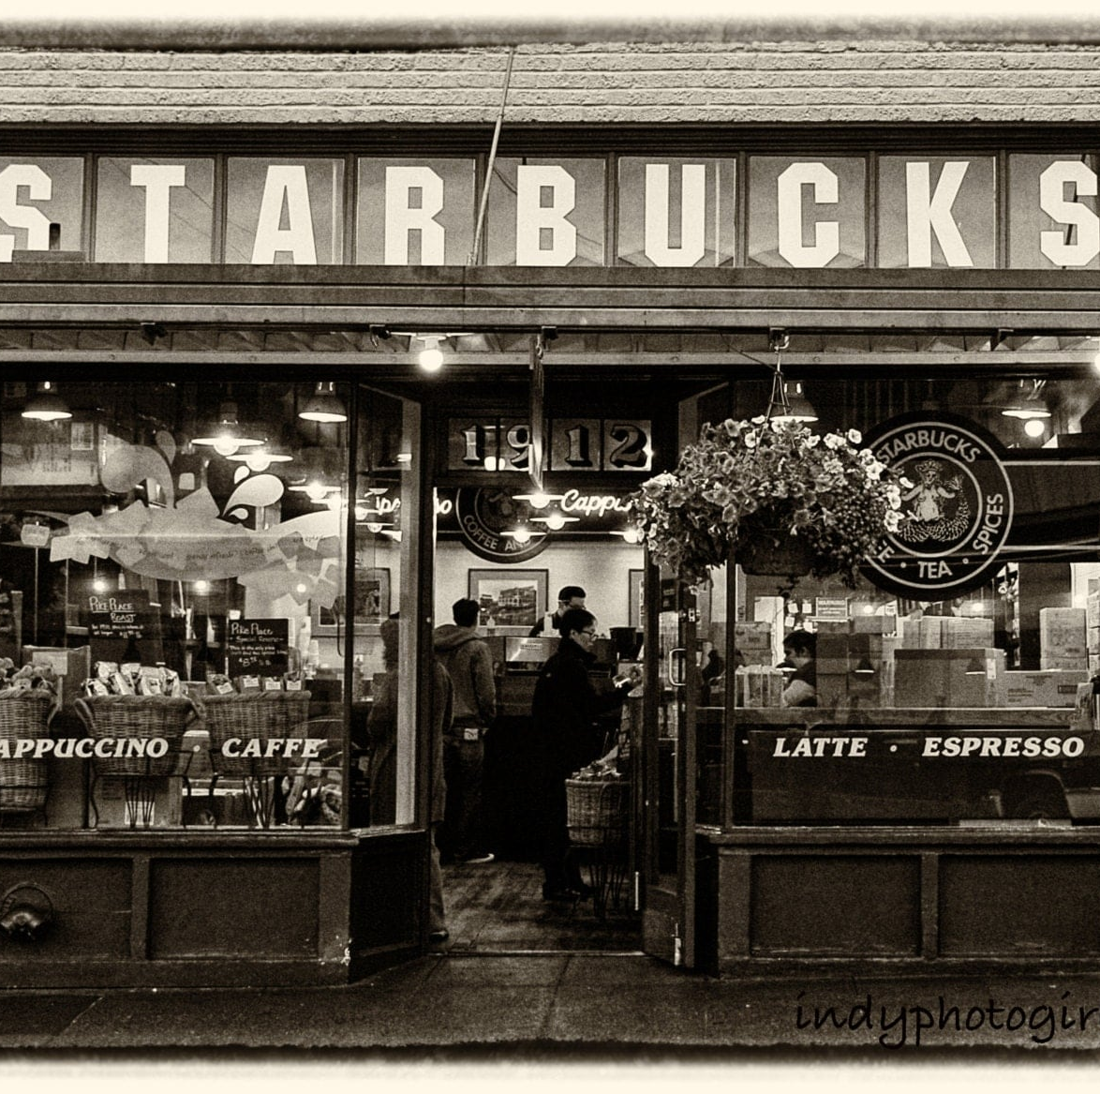
Overview Starbucks
Starbucks one of the largest coffee brands in internationally established in Seattle, Washington in 1971.
Founders of the company created the company for the love of coffee.
The company has over 35,000 stores worldwide.
Starbucks’ mission, “to inspire and nurture the human spirit – one person, one cup, and one neighborhood at a time,”
Notes:
Founded in Seattle, Washington, in 1971 Starbucks was established in Seattle, Washington, in 1971. The city’s vibrant culture and proximity to the coffee-growing regions of the Pacific Northwest played a pivotal role in shaping the company’s identity. Over time, Starbucks transitioned from a single store selling high-quality coffee beans to a global powerhouse that revolutionized the coffeehouse experience.
Born from a Love of Coffee The founders of Starbucks, Jerry Baldwin, Zev Siegl, and Gordon Bowker, created the company out of a profound love for coffee. Their goal was to introduce consumers to premium coffee sourced from the best beans worldwide. This passion laid the foundation for Starbucks’ emphasis on quality, innovation, and sustainability, which continues to drive its operations today.
A Global Presence with Over 35,000 Stores Today, Starbucks operates more than 35,000 stores across the globe, making it one of the most recognized coffee brands internationally. This extensive network allows Starbucks to cater to diverse consumer preferences while maintaining a consistent brand identity. Through strategic market expansions and the adaptation of store designs to local cultures, Starbucks continues to strengthen its presence in both established and emerging markets.
Mission Statement Starbucks’ mission, “to inspire and nurture the human spirit – one person, one cup, and one neighborhood at a time,” encapsulates its dedication to creating meaningful connections. This mission reflects the company’s core values of inclusion, sustainability, and community engagement. By prioritizing customer experiences and ethical business practices, Starbucks strives to build a lasting impact on both individual lives and the communities it serves.

Slide 22
References

