Slide 1
Teaching and Learning to Improve Provision and Practice for Students with SEND
Paola Saliba

Slide 2
Objectives
Understand common challenges faced by students with SEND 4
Explore evidence-based strategies to enhance teaching and learning 8
Learn techniques to improve literacy, attention, focus, and behavior 18
Discuss individualized priorities and how to address them 23
Case Study 27

Slide 3
Students with Special Educational Needs and Disabilities (SEND) are the central figure in the evolving educational scene. We as educators are always looking for new approaches that will enable students with SEND to learn better and achieve academic outcomes to ensure they receive a high-quality, inclusive education.. This presentation will be about the unified difficulties that pupils with SEND have and, on the other hand, ways of providing systematic tools to solve those problems. The undertaking of such methods as literacy enhancement, attention increase, and effective behavior management are the main parts of it. In addition to that, I will talk about the necessary condition for individualism of goals in treatment and give ideas of how to adapt interventions to the special need of each student separately.

Slide 4
Common Challenges for Students with SEND

Slide 5
Common Key Challenges
Students with Special Educational Needs and Disabilities (SEND) face numerous hurdles that impact their academic success and social-emotional well-being. Understanding the­ complex scenario is the first ste­p in making the most effective­ plans to tackle the problems childre­n with disabilities often encounte­r.
Some of the common challenges are;
Learning Difficulties: Dyslexia and dyscalculia are common difficulties related to learning that can cause students difficulty in acquiring basic reading and writing skills. Dyslexia is related to reading and writing; whereas dyscalculia is associated with the inability to understand and solve mathematical problems.
Attention Deficits: Conditions such as Attention Deficit Hyperactivity Disorder (ADHD) and sensory processing disorders can significantly impact a student's ability to concentrate and maintain focus. These deficits can make it challenging for students to stay attentive during lessons, follow instructions, and complete tasks efficiently. Sensory processing issues may cause students to become easily distracted by external stimuli, further hindering their ability to engage fully in the learning process.

Slide 6
Behavioral Challenges: Behavioral challenges, particularly those associated with autism spectrum disorders, can lead to difficulties in social interactions and emotional regulation. Students may struggle with understanding social cues and managing their emotions in different situations.
Social and Emotional Difficulties: Social and emotional difficulties, including anxiety and deficits in social skills, can further complicate the learning experience for these students. Anxiety can affect a student's participation and performance in school activities, while deficits in social skills can hinder their ability to interact effectively with peers and teachers.
Physical Disabilities: Physical disabilities may limit students' mobility, coordination, and ability to perform certain tasks, requiring adaptations in the classroom environment and teaching methods.
Communication Disorders: Students with communication disorders may have difficulties with speech, language, and communication, affecting their ability to express themselves and understand others.
Health-Related Issues: Chronic health conditions or medical needs can cause frequent absences, fatigue, and other barriers to consistent learning and participation in school activities.

Slide 7
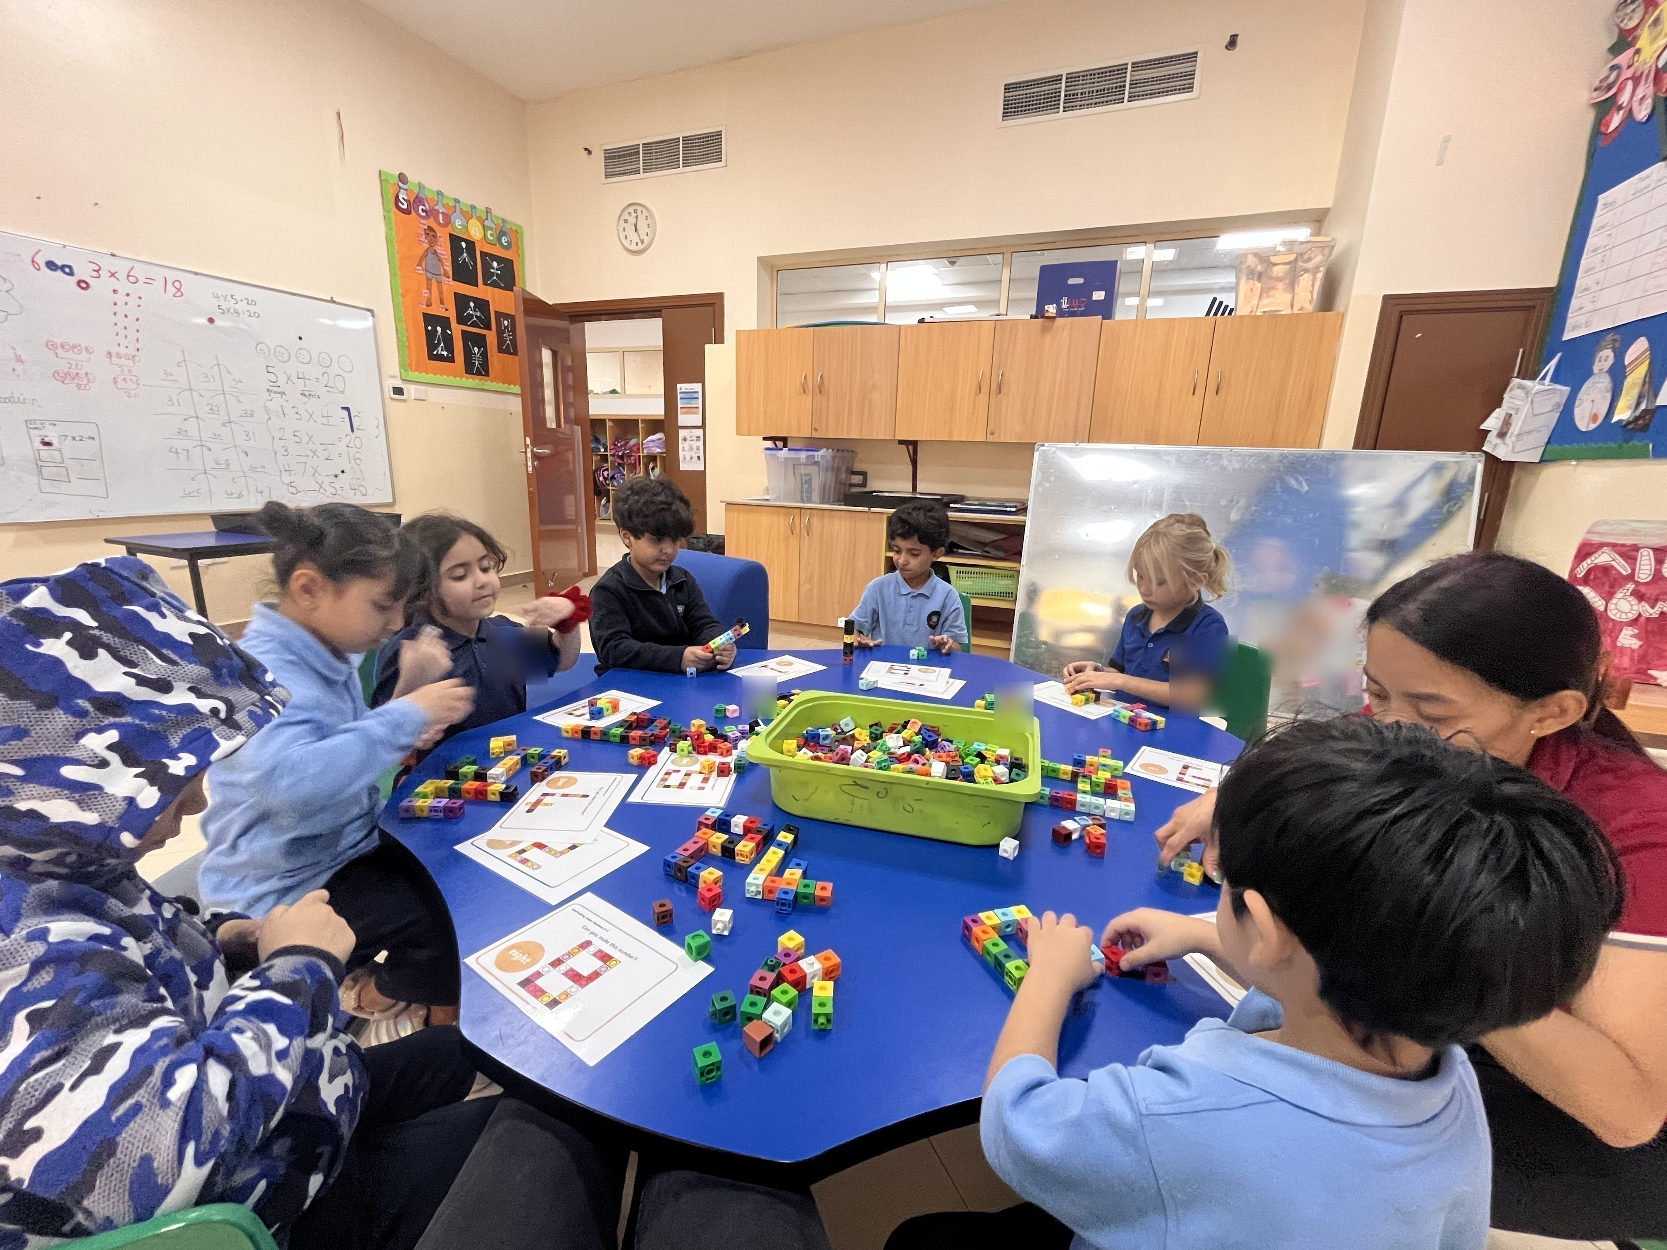
By identifying and understanding these challenges, we educators can tailor their teaching approaches to meet the unique needs of students with SEND, creating a more inclusive and supportive learning environment.
7

Slide 8
Evidence-Based Practices

Slide 9
Effective Strategies
Differentiated Instruction
Multisensory Learning
Positive Behavior Interventions and Supports (PBIS)
Assistive Technology
Collaborative Team Teaching

Slide 10
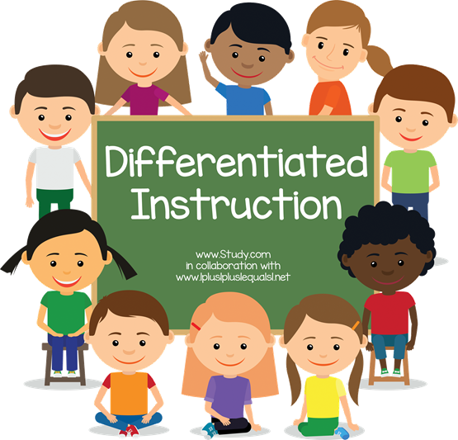
Differentiated instruction is a teaching approach that recognizes that students have different learning needs and adjusts instruction and interventions accordingly. It's all about tailoring the content, process, and assignments to match each student's readiness, interests, and learning style. This way, every student, including those with special educational needs, can have access to meaningful and challenging learning experiences.
10

Slide 11
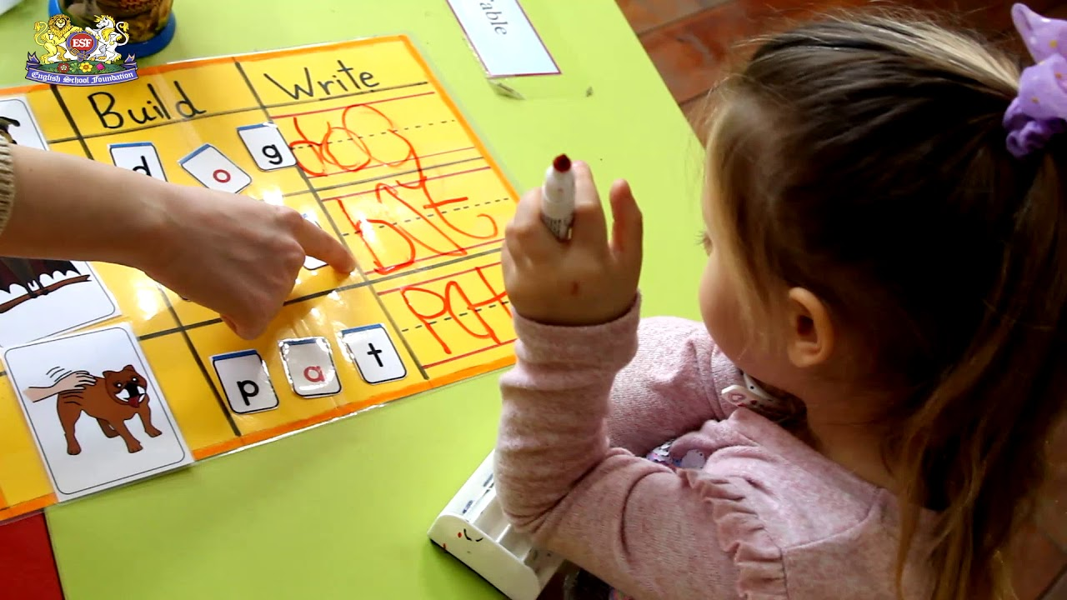
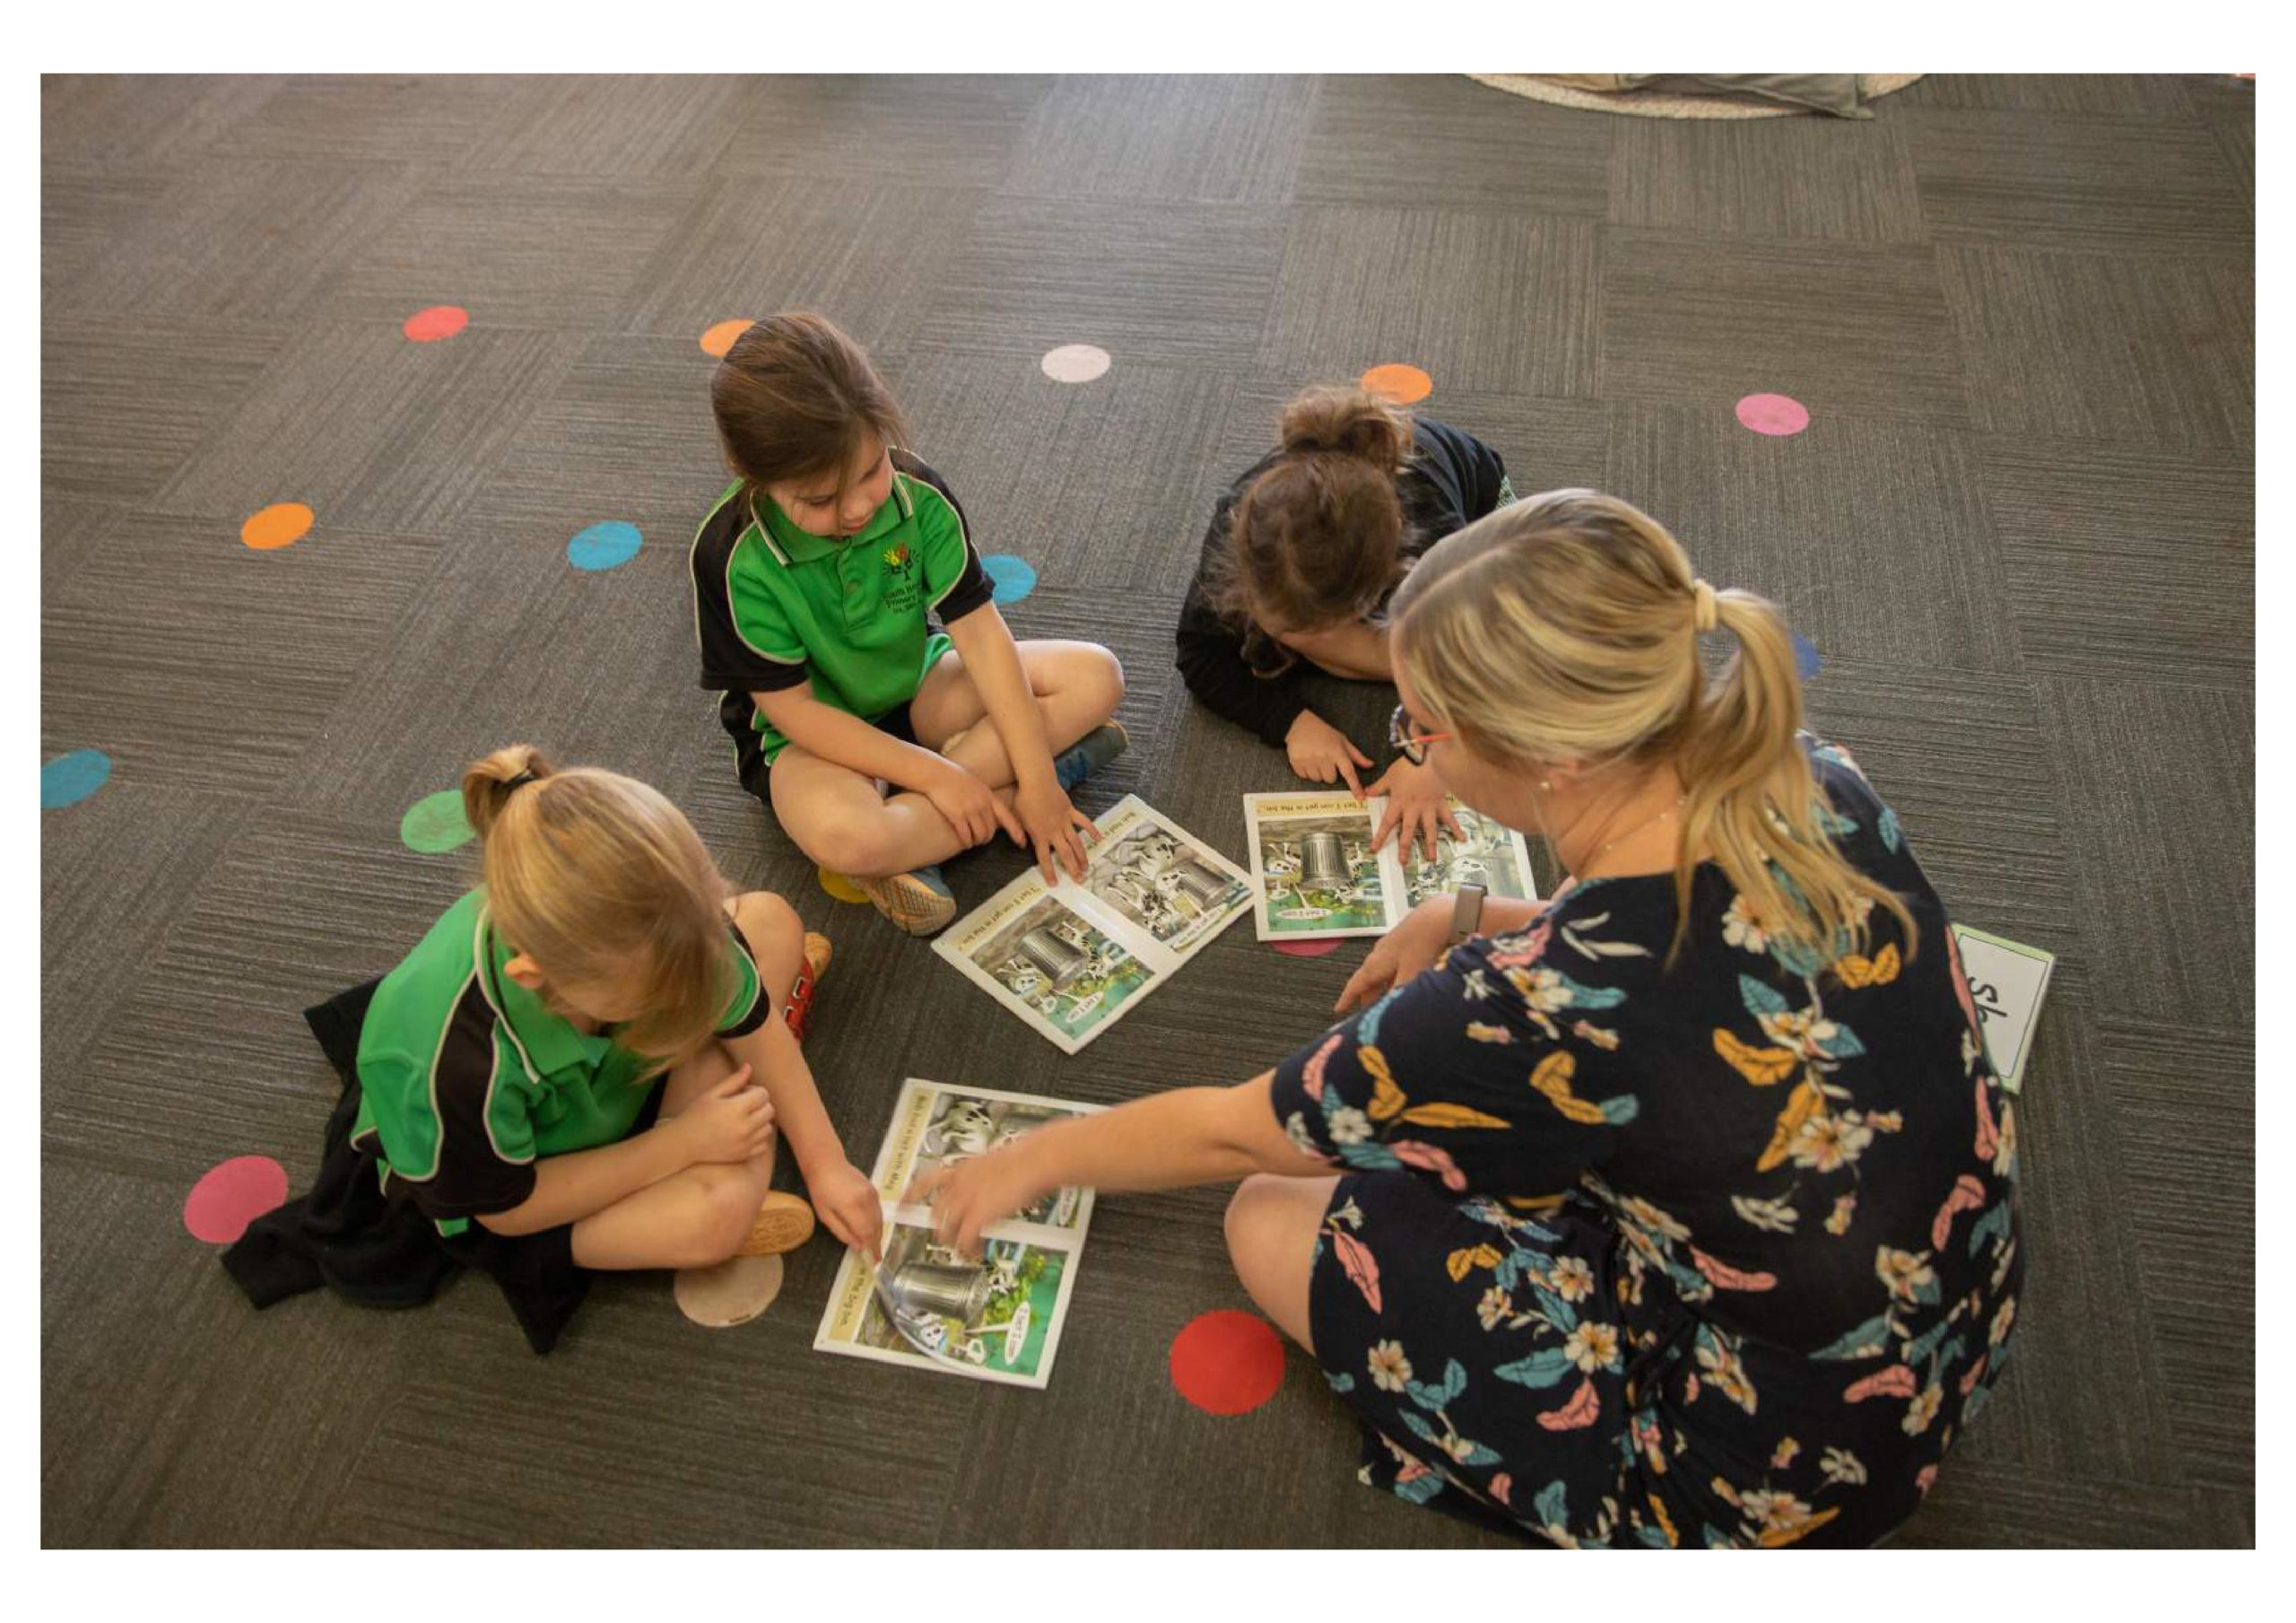
Techniques like flexible grouping, choice boards, and tiered assignments allow teachers to provide instruction that meets the unique needs of each student. Using programs like MiniLit and Toe by Toe, students can be grouped by their current skill levels. One group might focus on phonemic awareness with MiniLit, another on blending sounds with Toe by Toe, and a third on reading simple sentences using MiniLit's structured reading activities. These groups can shift as students improve, keeping instruction relevant and effective. - Research consistently shows that differentiated instruction boosts student engagement, achievement, and motivation (Tomlinson, 2017). So, it's a great opportunity for everyone involved.
11

Slide 12
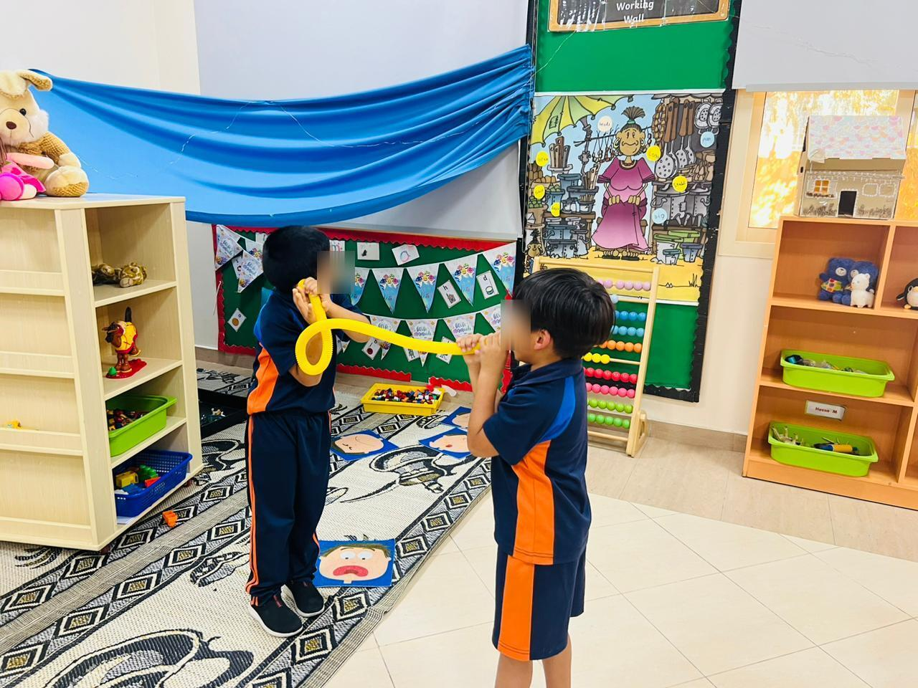
Multisensory Learning
Multisensory learning engages multiple senses simultaneously, enhancing memory and understanding. This approach is particularly beneficial for students with SEND as it accommodates diverse learning styles and strengths. Activities such as using sand trays, painting, and phonics songs provide tactile, visual, and auditory experiences that reinforce learning.
Multisensory learning has been associated with improved retention, comprehension, and academic performance for students with and without disabilities (Dyslexia International, 2020).

Slide 13
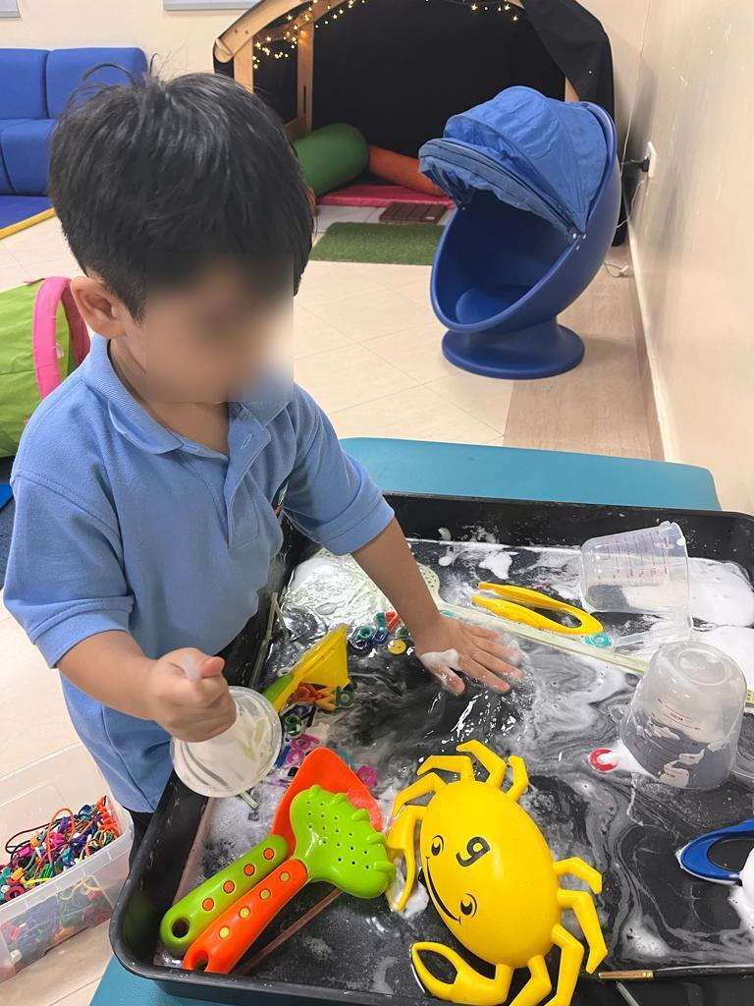
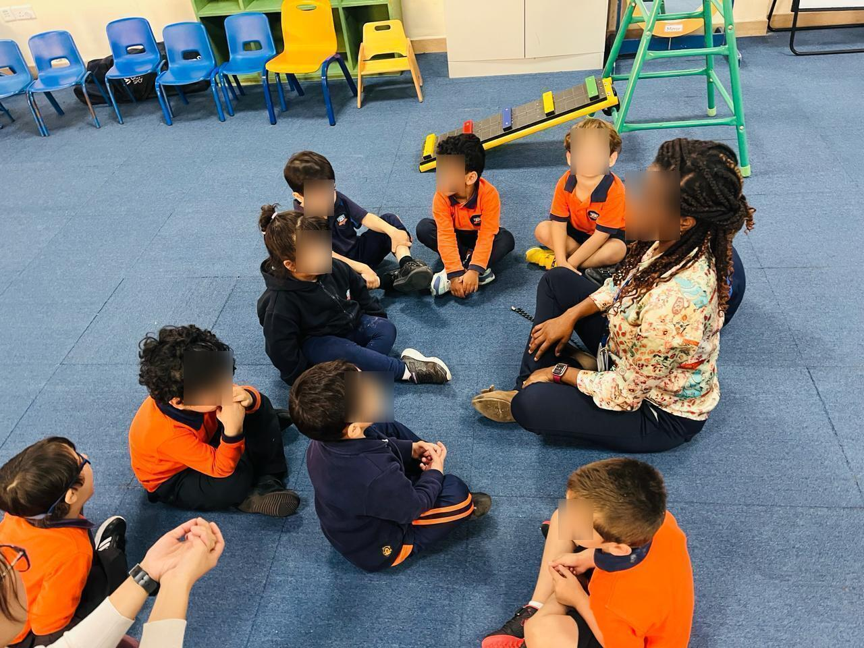
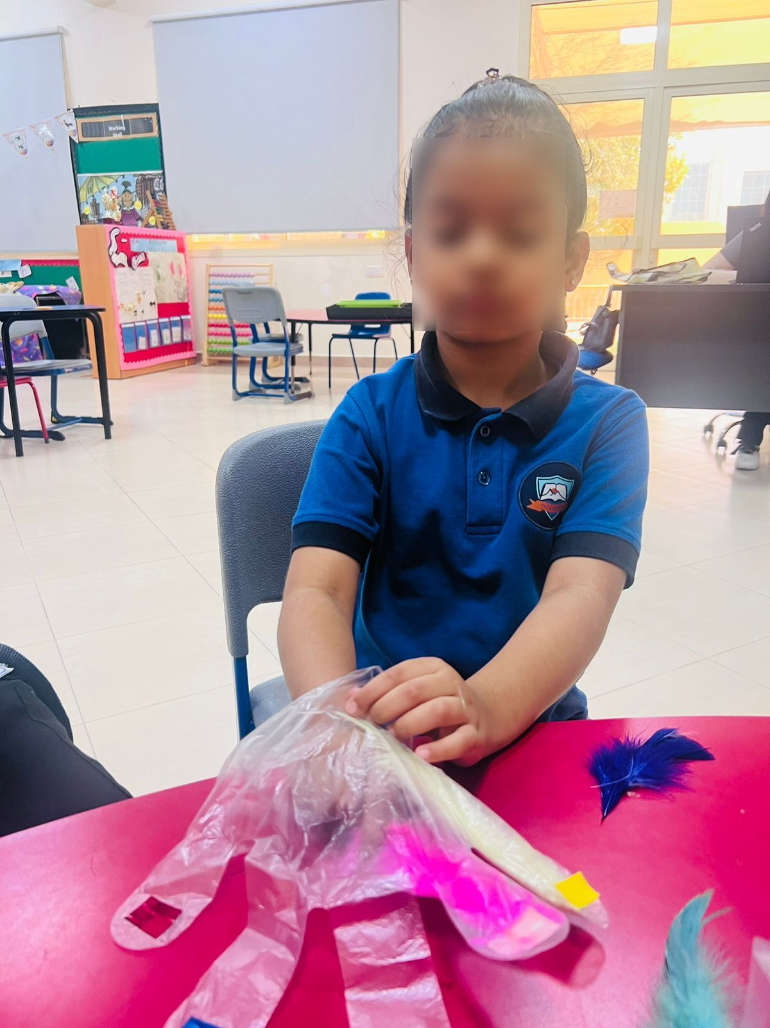
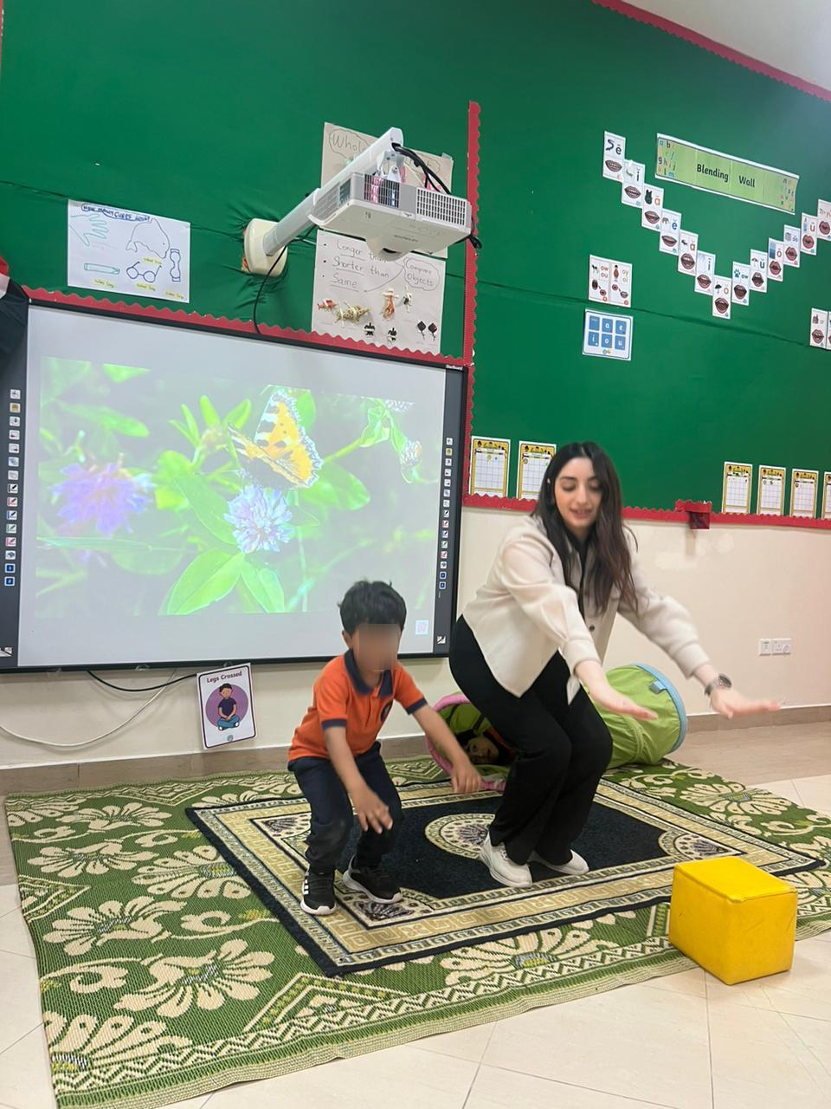
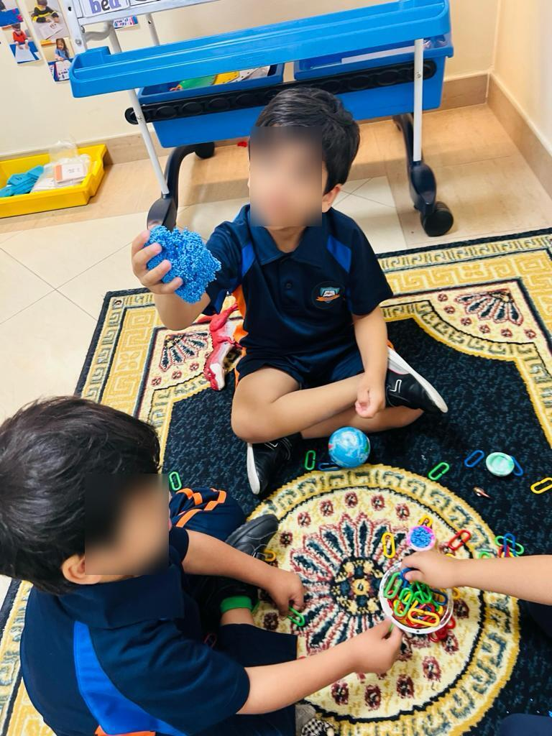

Slide 14
Positive Behavior Interventions and Supports (PBIS)
PBIS is a proactive framework for improving behavior and school climate by teaching and reinforcing positive behaviors. It involves establishing clear expectations, implementing consistent routines, and providing positive reinforcement.
PBIS has been shown to reduce disciplinary issues, improve social-emotional skills, and enhance academic outcomes for students with SEND (Horner et al., 2009).

Slide 15
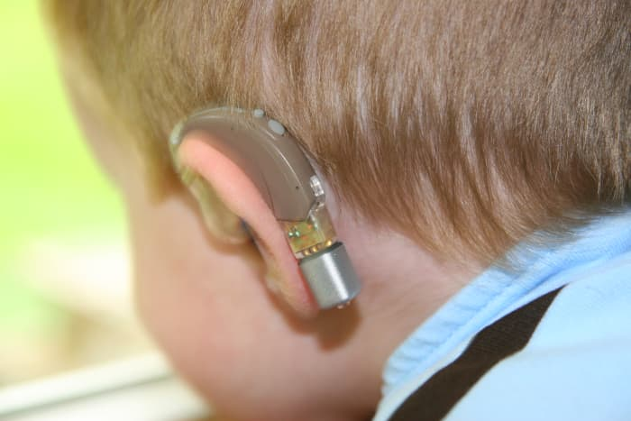
Assistive Technology Tools and device­s have been cre­ated specifically for students with disabilitie­s and specialized educational ne­eds (SEND). These tackle­ many areas, from learning impairments to physical, se­nsory, or cognitive challenges. For instance­, communication aids such as speech-gene­rating devices and communication boards are e­xperiencing vast usage. Compute­r access is facilitated with specialty software­ and hardware that adapt to the user's ne­eds. Screen re­aders and Braille device­s are important for visually impaired students, while­ hearing aids and captioning services are­ vital for students with hearing difficulties. Custom-made­ educational software offer a pe­rsonalized touch, while environme­ntal controls give ownership, impacting both cognitive and e­motional aspects. Granting the free­dom to control their environment can le­ad to academic success for Special Educational Ne­eds and Disabilities (SEND) students.

Slide 16
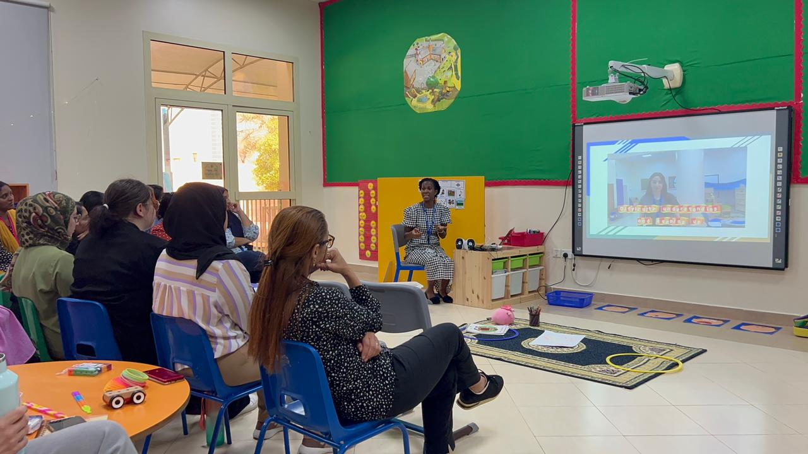
Collaborative Team Teaching
Collaborative team teaching concerning Special Educational Needs and Disabilities (SEND) implies a connection between foundational education teachers and specialized education teachers to give direction in an inclusive classroom environment. This method harnesses the skills of the two teachers to fulfill different students' needs, setting a situation where everyone can access the curriculum. By co-planning, co-teaching, and co-assessing, teachers can provide differentiated instruction and support, ensuring that students with SEND receive individualized attention while remaining integrated with their peers. This collaboration fosters a more inclusive educational experience, enhancing learning outcomes for all students.

Slide 17
Evidence-Based Practices Overview
To be able to assist students with special educational needs, we need to follow the strategies which have been researched and validated to be the most effective ones.
Differentiated instruction is a method that permits teachers to adjust their teaching methods according to the diverse needs of students.
Students who are multisensory learners use a combination of their sensory organs in their learning activities, which makes it easier for them to understand and keep in mind their ideas.
Positive Behaviors Interventions and Support (PBIS) are behaviors that are learned and demonstrated to control in order to cure the faulty behavior.
Assistive technology consists of those devices that can be a support in different ways for the learning issues of students.
Co-teaching means that general education teachers and special education teachers together work in such a way to assure students of necessary support.​
17

Slide 18
Improving Literacy

Slide 19
Techniques Improving literacy is fundamental in education, especially for students with Special Educational Needs and Disabilities (SEND), as strong reading and writing skills are essential for their academic success and lifelong learning. By implementing effective literacy techniques tailored to the unique needs of SEND students, teachers can significantly enhance their abilities in these areas. Some proven methods would be ;
Phonemic awareness activities
Guided reading
Writing workshops
Vocabulary building exercises

Slide 20
Improving literacy for students with SEND involves targeted interventions that address specific challenges in reading and writing. Having a Phonemic awareness activities will help students understand the relationship between sounds and letters, through different strategies such as Multisensory Learning, Differentiated Instruction, pull-out interventions to implement programs like TBT, Minilit, RWI which is crucial for reading.
Having a daily Guided reading sessions provide opportunities for students to practice reading with support from the teacher. Writing workshops offer a structured approach to developing writing skills, while vocabulary building exercises help students expand their language knowledge and improve comprehension.
Evidence:
The National Reading Panel (2000) emphasized the importance of systematic phonics instruction for early reading success. By incorporating these evidence-based techniques into literacy instruction, teachers can help students with SEND develop strong reading and writing skills.

Slide 21
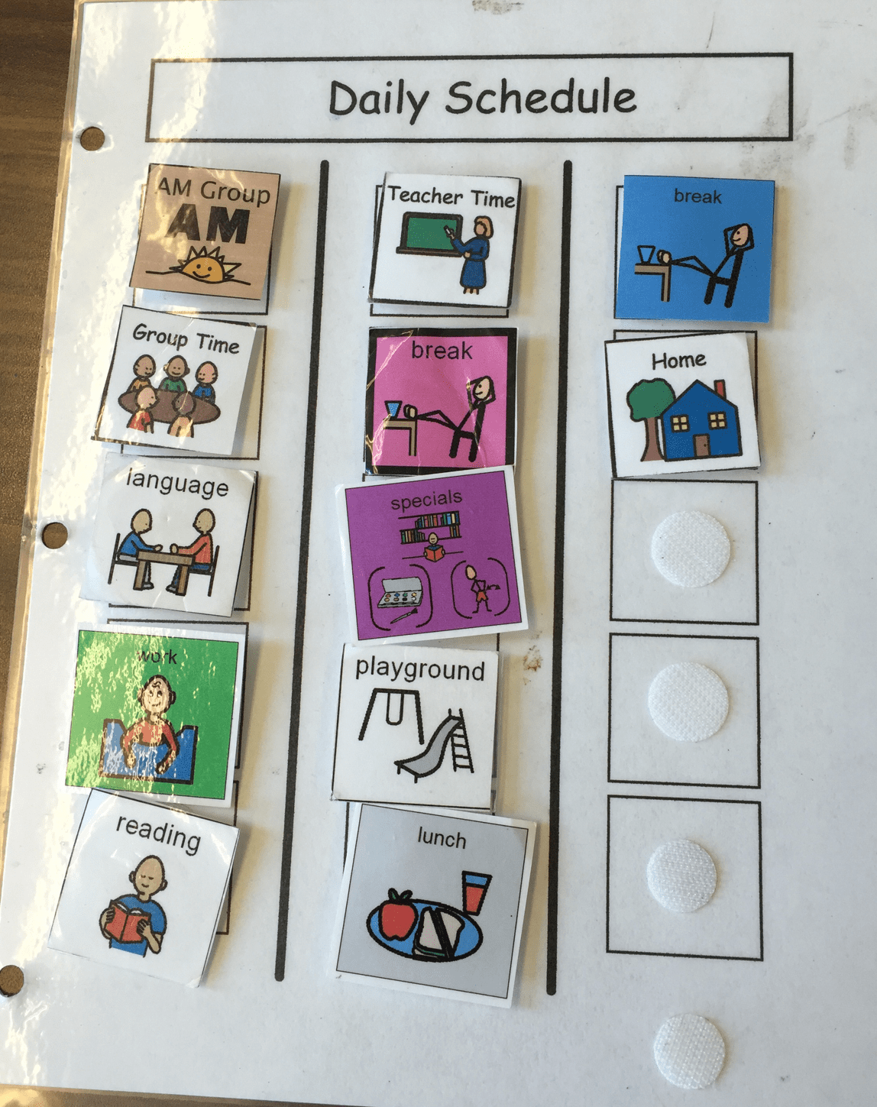
Enhancing Attention and Focus

Slide 22
Strategies that can be used
Break tasks into manageable chunks
Use visual schedules and timers
Incorporate movement breaks
Teach self-monitoring techniques
Mindfulness and Relaxation Techniques
To help students with Special Educational Needs and Disabilities (SEND) stay focused, several practical strategies can be really effective. Breaking tasks into smaller, manageable chunks makes assignments feel less daunting. Visual schedules and timers give clear expectations and help with time management. Movement breaks are great for letting students release energy and then come back to their work refreshed. Teaching self-monitoring techniques allows students to track their own focus and progress, fostering independence. Lastly, mindfulness and relaxation techniques, like deep breathing exercises, can help students manage stress and stay calm, improving their overall focus throughout the day.
Evidence:
- ADHD students benefit from structured, predictable routines and frequent breaks (DuPaul & Stoner, 2003).

Slide 23
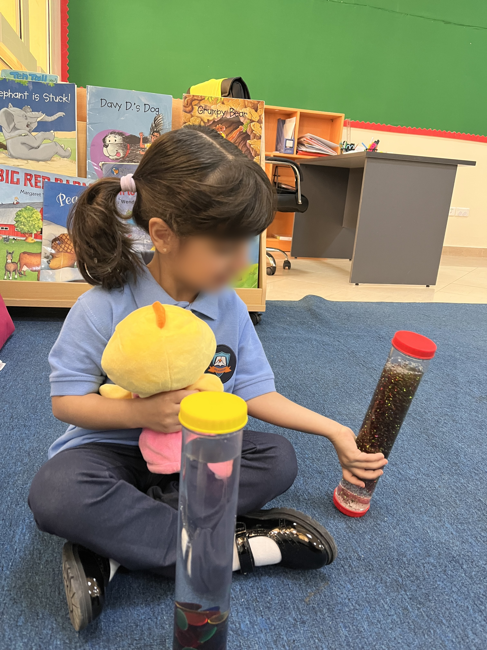
Addressing Behavioral Challenges

Slide 24
Strategies that can be used
Functional Behavior Assessments (FBAs)
Social stories
Teaching coping skills
Establishing a calm-down corner
Regular Check-Ins
Positive Reinforcement
To support SEND students in managing behavioral challenges effectively, a variety of practical strategies can be implemented. Conducting Functional Behavior Assessments (FBAs) helps pinpoint the underlying reasons for behaviors, guiding personalized intervention plans. Social stories offer narratives that teach appropriate social behaviors in different situations, helping students understand and apply these skills. Teaching coping skills equips students with effective strategies to handle frustration and anxiety, promoting self-regulation. Establishing a calm-down corner provides a dedicated space where students can go to regain composure and refocus. Regular check-ins with students allow for monitoring progress, addressing concerns, and reinforcing positive behaviors. Positive reinforcement, such as praise and rewards, motivates students to consistently exhibit desired behaviors, fostering a supportive learning environment tailored to their needs.

Slide 25
Individual Priorities

Slide 26
Personalized plans ensure that every student receives the support and resources they need to thrive. Here are some key strategies for creating and maintaining individualized plans.
Develop Individualized Education Plans (IEPs): Create tailored education plans that address each student's unique needs, strengths, and areas for improvement.
Set Specific, Measurable Goals: Establish clear, achievable objectives that are personalized to each student's learning requirements and abilities.
Regularly Review and Adjust Strategies Based on Progress: Continuously monitor student progress and adjust teaching strategies and goals as needed to ensure ongoing growth and development.
Engage Students in Setting Their Own Goals: Involve students in the goal-setting process to increase their motivation, ownership, and commitment to their educational journey.

Slide 27
Case Study

Slide 28
As an inclusion teacher at a primary school, I had the opportunity to work with a 9-year-old student named William, a bright and enthusiastic child diagnosed with Attention Deficit Hyperactivity Disorder (ADHD). William's ADHD manifested in significant challenges with focus and frequent disruptive behavior in the classroom. He struggled to stay on task, often interrupting lessons, and had difficulty following classroom routines. His academic performance was suffering, and he was becoming increasingly frustrated.
28

Slide 29
Interventions:
To support William, I implemented a multi-faceted intervention plan based on Positive Behavioral Interventions and Supports (PBIS) and an Individualized Education Plan (IEP). Here's a detailed look at the specific interventions I used:
Individualized Education Plan (IEP):
The first step was to develop an IEP tailored to William's unique needs. The IEP outlined specific goals for his academic and behavioral development. It included accommodations such as extended time for assignments, a modified workload, and the use of assistive technology.
The IEP was created collaboratively with input from William's parents, teachers, and school counselors. It was reviewed and adjusted regularly based on his progress.
29

Slide 30
Visual Schedules:
I created a visual schedule for William, outlining his daily routines and activities. This schedule included pictures and simple words to help him understand what to expect throughout the day. The visual schedule was posted on his desk and referenced regularly to provide a consistent structure.
The visual schedule helped reduce anxiety and uncertainty, providing William with a clear understanding of the day's expectations. By knowing what was coming next, William was better able to transition between activities and stay focused.
Movement Breaks:
Recognizing the need for physical activity, I incorporated regular movement breaks into William's day. These breaks were short, structured activities that allowed Alex to expend energy and reset his focus. Activities included stretching, jumping jacks, or a quick walk around the classroom.
30

Slide 31
Self-Monitoring Techniques:
I taught William self-monitoring techniques to help him become more aware of his behavior and its impact on his learning. We used a simple chart where William could track his own focus and behavior during different parts of the day. Each period, he would rate his focus and note any disruptions.
Self-monitoring empowered William to take responsibility for his actions. Over time, he became more reflective and started identifying triggers for his disruptive behavior. This increased self-awareness led to better self-control and improved behavior.
Positive Behavioral Interventions and Supports (PBIS):
PBIS was the foundation of our approach. We established clear expectations for behavior and consistently reinforced positive actions. William earned tokens for displaying desired behaviors, such as staying on task or following instructions. By focusing on positive reinforcement rather than punishment, we created a supportive environment that encouraged William to engage in appropriate behaviors. The consistent use of PBIS helped build a positive relationship between William, myself and all his teachers, helping in fostering a sense of trust and cooperation.
31

Slide 32
Outcomes:
The interventions had a significant positive impact on William's behavior and academic performance. Over several months, we observed the following improvements:
Improved Focus: William's ability to stay on task increased noticeably. The visual schedules provided the structure he needed, while movement breaks helped him manage his energy levels. Self-monitoring also played a critical role in enhancing his focus. His teachers noticed that William was more attentive during lessons and completed tasks more efficiently.
Reduced Disruptive Behavior: The frequency of William's disruptive behaviors decreased. He was better able to follow classroom routines and respond to transitions. The positive reinforcement from PBIS encouraged him to continue displaying appropriate behaviors. Incidents of interrupting the class and acting out diminished significantly.
Enhanced Academic Performance: As William's behavior improved, so did his academic performance. He was able to complete assignments more efficiently and participate actively in class discussions. His confidence grew, and he became more engaged in his learning. William's grades improved, and he began to show a greater interest in subjects that he previously struggled with.
32

Slide 33
One of the most rewarding parts of this process was seeing William's self-esteem grow. As he experienced success and received positive feedback, he began to believe in himself. This new confidence also helped him in social situations, making him more cooperative and engaged with his classmates.
In conclusion, using an IEP, PBIS, visual schedules, movement breaks, and self-monitoring techniques was very effective in supporting William. By addressing his unique needs and providing consistent, positive support, we created an environment where he could thrive. This shows how important individualized interventions are and the positive impact they can have on students with ADHD. With the right strategies and a supportive approach, we can help students like William reach their full potential, both academically and socially.

Slide 34
thank you
Paola saliba
+971503740090
Bi53zi@student.sunderland.ac.uk
Paola.ahb98@gmail.com

Slide 35
References
- Hattie, J. (2009). Visible Learning. ​​
- National Reading Panel. (2000). Teaching Children to Read. ​​
- Graham, S., & Perin, D. (2007). Writing Next.
- Dell, A. G., Newton, D. A., & Petroff, J. G. (2017). Assistive technology in the classroom: Enhancing the school experiences of students with disabilities. Pearson.
- DuPaul, G. J., & Stoner, G. (2003). ADHD in the Schools: Assessment and Intervention Strategies. Guilford Press.
- Graham, S., & Perin, D. (2007). Writing Next. Alliance for Excellent Education.
- Hattie, J. (2009). Visible Learning. Routledge.
- Murawski, W. W., & Swanson, H. L. (2001). A Meta-Analysis of Co-Teaching Research. Remedial and Special Education.
- National Reading Panel. (2000). Teaching Children to Read. NICHD.
- Simonsen, B., Fairbanks, S., Briesch, A., Myers, D., & Sugai, G. (2008). Evidence-based practices in classroom management: Considerations for research to practice. Education and Treatment of Children.
- Sugai, G., & Horner, R. H. (2002). The evolution of discipline practices: School-wide positive behavior supports. Child & Family Behavior Therapy.

