Slide 3
One column Headline Calibri Bold 28 pt
Headline Calibri 18 pt
Calibri 18 pt Dolor situs cum habilitarum itum alusi ex landum it exus rius cum habilitarum itum alus ex landum it lorem exit itum alus causticus. Dolor situs cum habilitarum itum alus causticus sit imane nter status ex landum it exus rius laudanum itum caiusticus. Dolor situs cum habilitarum itum alus causticus imanenter status ex landum it alus causticus.
Dolor situs cum habilitarum itum alus causticus sit imane causticus sit imane nter.
Status ex landum it exus rius enter.
Situs cum habilitarum.
Dolor situs cum habilitarum.
Status ex landum.
Landum it alus causticus.

Slide 4
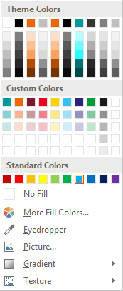
Appendix – Color
Theme Colors
Correct color ratio
Theme Colors
Don’t use the given gradation colors from PowerPoint.
Custom Colors
Our Primary, Additional and Functional Colors.
0
0 0
255 255 255
191 191 191
236 102 2
236 102 2
Text/Bkgrd
Dark 1
Text/Bkgrd
Light 1
Text/Bkgrd
Dark 2
Text/Bkgrd
Light 2
Accent 1
Our vibrant Primary Colors palette expresses a bright personality.
When an application requires more than four primary colors (including white) the Additional Colors can be used for complex infographics and the Functional Colors for instance for traffic sign symbols or warning signs/symbols.
0
0 0
0 153 153
64
64
64
128
128
128
191
191
191
Accent 2
Accent 3
Accent 4
Accent 5
Accent 6
Custom Colors = Additional Colors + Functional Colors
Useful symbols
0 153 153
236
102
2
122
22
45
231
0
29
255
210
0
58
191
237
43
36
131
0
154
56
27
27
27
208
208
208
135
210
210
249
181
145
198
155
158
243
128
142
255
233
128
157
223
246
149
146
193
128
204
156
146
146
146
236
236
236
200
230
230
253
221
203
233
209
212
249
191
199
255
243
191
206
239
251
202
200
224
191
230
205
183
183
183

