Slide 1
The Practitioner as Leader for those Working with Children and Young People with SEND
SENM04
Assessment Guidelines

Slide 2
Overview
Two parts
Part 1 (60%)- 3,000 words equivalent
Part 2 (40%)- 2,000 words equivalent
Entirely based on academic literature and research (and your summary of the reading you have accessed)
Written in the third person
Applicable to work-based context
Assessed against the Generic Assessment Criteria for Level 7 (see CANVAS)
Submit as one document
Submission date: 23:59GMT 9th July 2024 via link on CANVAS

Slide 3
Part 1 rationale
This part of the assessment is designed to get you thinking about some key whole-school developments that you have determined would benefit your provision.
You will explore 2-4 different themes using literature to support your discussion
Examples of themes could be: Differentiation, Transitions, Assessment, Tracking, Support for children and young people with Anxiety, Pupil Voice, Family Leadership etc.
The final choices are entirely up to you but must be related to SEND provision and practice
You will have created materials that you can use to deliver to staff (at any time) guidance on how your key themes can be adapted to improve outcomes for children and young people with SEND

Slide 4
Part 1 assessment
Design and deliver a 30 minute structured CPD session related to SEND priorities within your context.
This CPD session must be based on a critical reflection on current and relevant evidence-based practice.
The CPD will be assessed either by you uploading the CPD materials (with presenter notes if required) or via a video submission of the session.
Due to the challenging circumstances in different schools this can be recorded in the absence of staff if this is your chosen method of submission.

Slide 5
Part 2
A personal action plan based on 3 targets related to SEND provision in your context for the next 12 months alongside the methods you will use to achieve these (optional template provided).

Slide 6
Part 2 rationale
This part of the assessment is designed for you to devise three personal development targets related to your practice.
These targets can be chosen for you and should be relevant to you for the next 12 months
The targets must be related to SEND provision and practice
Example targets could include (but should be different from those in Part 1): Differentiation, specific SEND evidence-based practice, Assessment, working with parents/carers (Family Leadership), Interventions, Deployment of Tas etc.
The discussion must be entirely based on literature and a critical reflection on your reading
There is a suggested template on CANVAS but you can choose any format that suits your purpose.

Slide 7
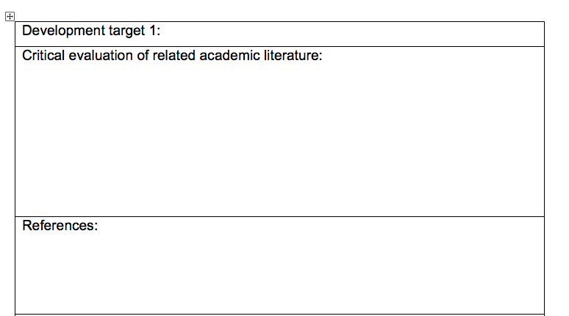
Part 2- Optional Template (available on canvas)

Slide 8
If you have any questions at all, as always, please contact me
Every best wish
Simon

